Slide 1

Python Web-Scraping Program
Report 2
10.4.2024
Notes:
Cover Page

Slide 2
Members:
Role:
Mike Gorman………………………………………Coder Matt Laskowski………………………………….. Mike Fillinger……………………………………… Sean Kehoe………………………………………… Anthony Girgenti……………………………..... David Itskov………………………………………..
Notes:
Roles:
Writer (does the manual, presentation)
Coder (writes source code, fixes bugs)
Tester (finds the bugs)
Designer (produces the design)

Slide 3


Design (1 of 2): enter name
Design Concept:
Create GUI prompt box
Prompt user to select a category
Selection will open website
Scrape headlines from websites
Return headlines to a second GUI
Headlines will be clickable links
Links will be sortable by ‘Views’ & ‘Rating’
Refresh button will restart the process over

Slide 4


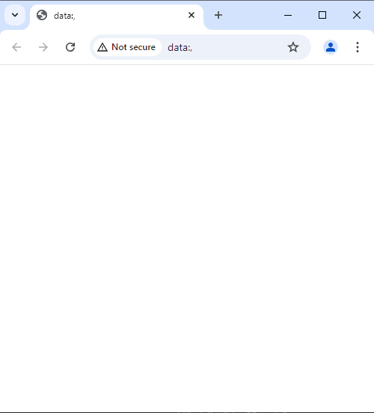


Design (2 of 2): enter name
Visual Concept:
Website from link
Main Website
Link…
Link…
Link…

Slide 5





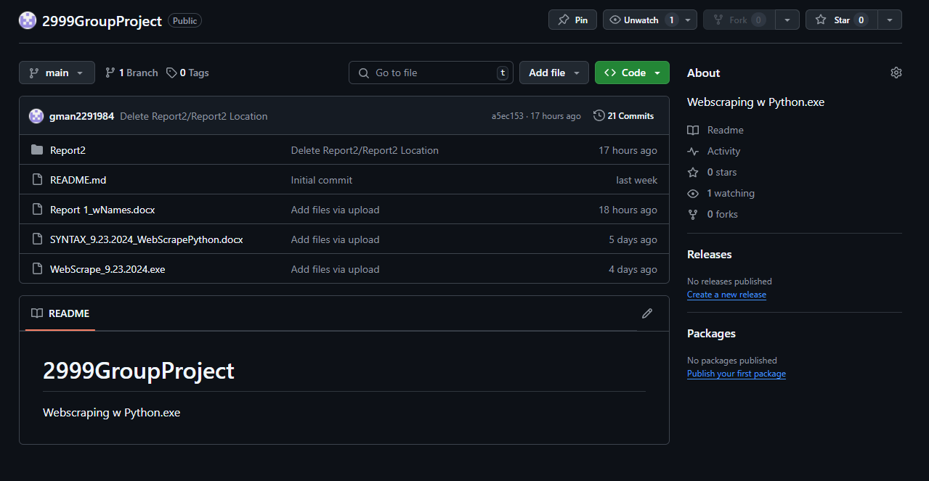
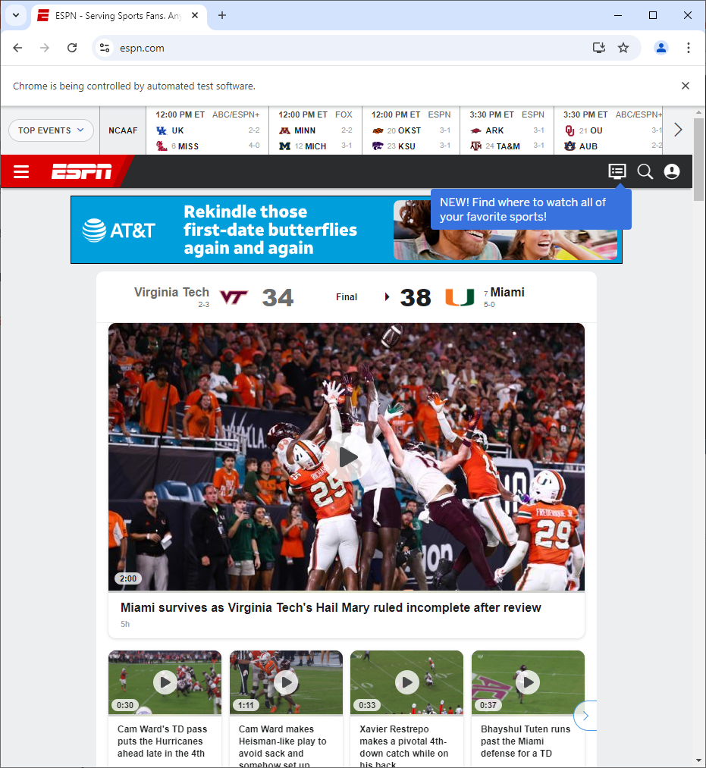

Code: enter name

Slide 6
Tester: enter name

Slide 7
Writer: enter name

